Slide 1
Team 5:
Signal Model Max
Atef Ajmal, Joaquim Curvo Neto, Philip Bonner, Kellye Rogers
Notes:
Kellye Title Slide: Include the name of the project and group members.

Slide 2






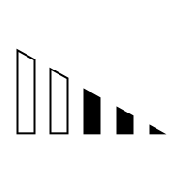



SIGNALS
FEATURES
MODELS
TRAIN
PORTFOLIO
BUILDER
TO
MAXIMIZE
RETURN
Volatility
Random Forest
Neural Network
Trend
EVALUATION
Clustering
Volume
Momentum
MLP
Notes:
Kellye
Stock closing prices: 5 years back (October 6th 2015 to October 5th of 2020)
We’ll build the signals that shape different trading strategies that will become the features of our models.
Build the models
Train the models
Run stocks through the model and get an output.
Determine what features or models work best?
We’ll end up with a graph on each model for how well that model worked for our portfolio of stocks.

Slide 3





The Data
Algo Proof of Concept
Build a Portfolio
We used Twitter, but the idea is that once the signals and models are all in place, you could run any stock through our algorithm to match it with the right signals, features, and model that should govern the buy/sell/hold strategy for that stock, to create the greatest chance to maximize return.

Slide 4
Features for the Models
Signals used for the trading decision:
Stock: Twitter (TWTR)
Library: ta (Technical Analysis)
Volatility:
Crossover
Vol_trend
Bollinger band
Trend:
Vortex indicator
KST oscillator
Momentum:
MLP - Twitter
Relative Strength Index (RSI)
Stochastic Oscillator (SR)
Volume:
Negative Volume Index
Money Flow index
Notes:
Joaquim

Slide 5
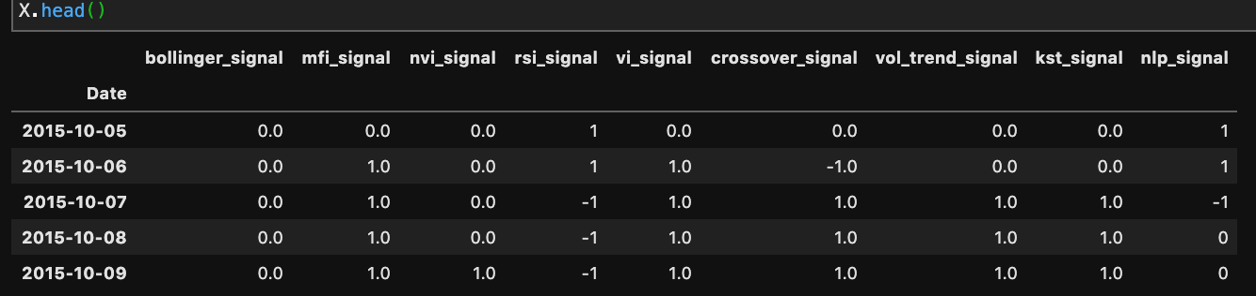
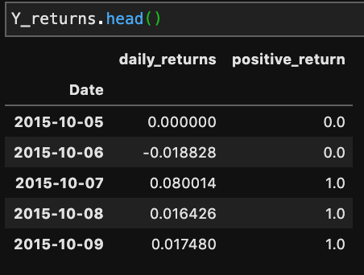
What the data looks like:
Features (X):
Target (Y):
Time window: 5 years

Slide 6
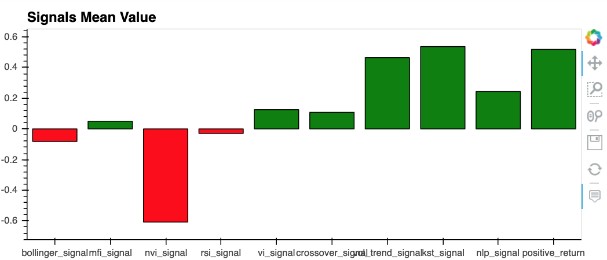
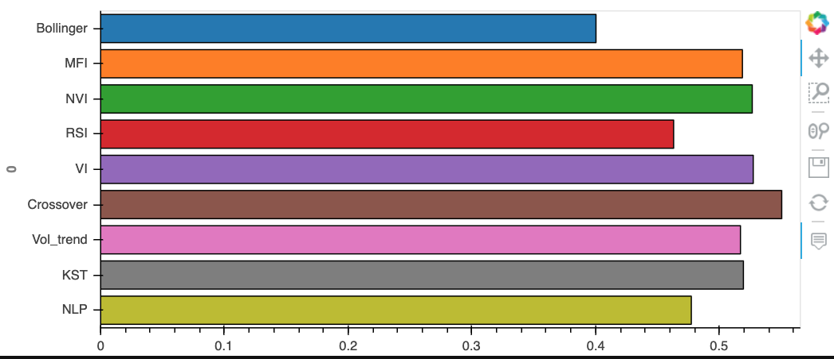
Details of the signals dataset
Features in red indicate a bearish approach to the stock in question.
Features in green have a majority bullish position.
Crossover is the feature that most matched the Actual Results of the stock.

Slide 7
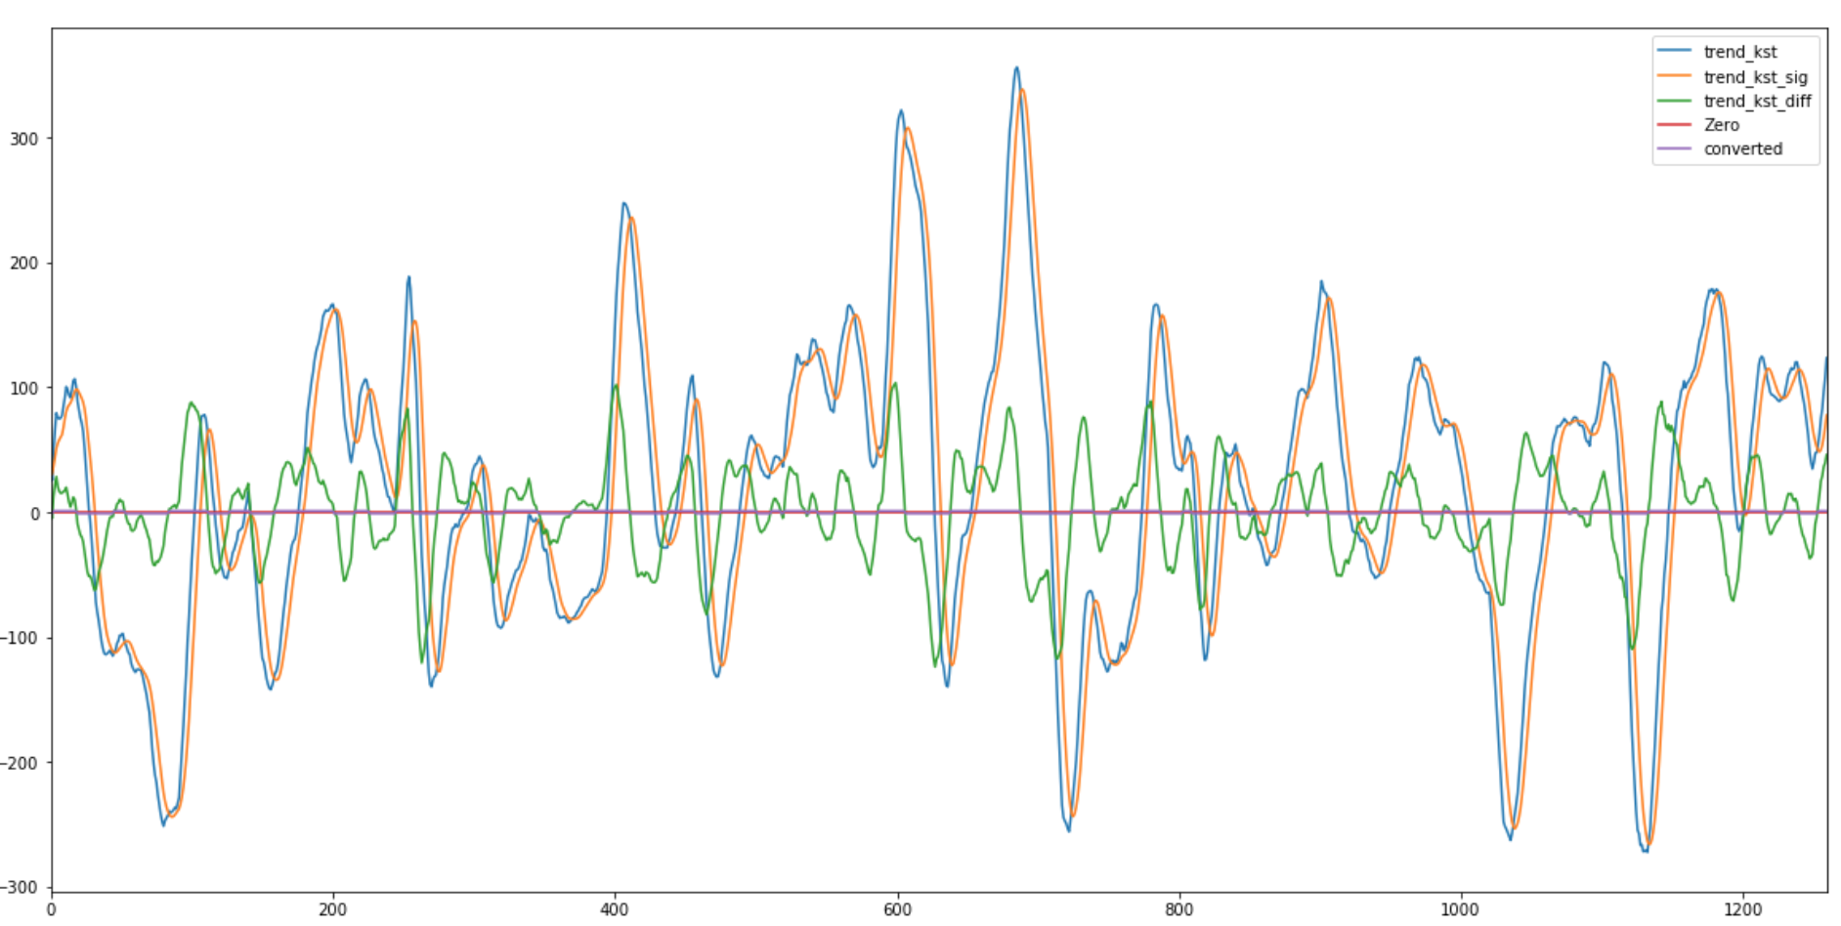
Details of the signals dataset
Notes:
Kellye - I did the crossover signal, the vol-trend signal and the KST. KST is a complex, smoothed price velocity indicator. KST indicator is useful to identify major stock market cycle junctures (typical cycle 24-months) because its formula is weighed to be more greatly influenced by the longer and more dominant time spans, in order to better reflect the primary swings of stock market cycle. The concept behind the oscillator is that price trends are determined by the interaction of many different time cycles and that important trend reversals take place when a number of price trends are simultaneously changing direction.
The Know Sure Thing (KST) Indicator is a two-line indicator. A buy signal is generated when the Know Sure Thing (there’s a formula for producing the KST trend line which is blue) crosses above the zero line or makes a crossover above its KST signal line. If the KST crosses below the zero line or makes a crossover below the signal line a sell signal is generated

Slide 8
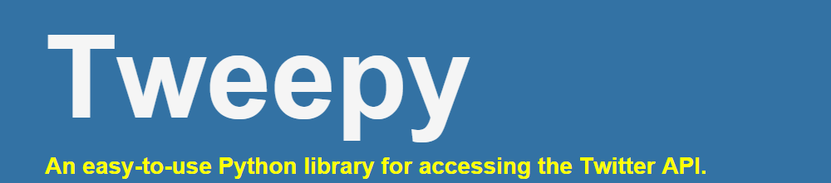

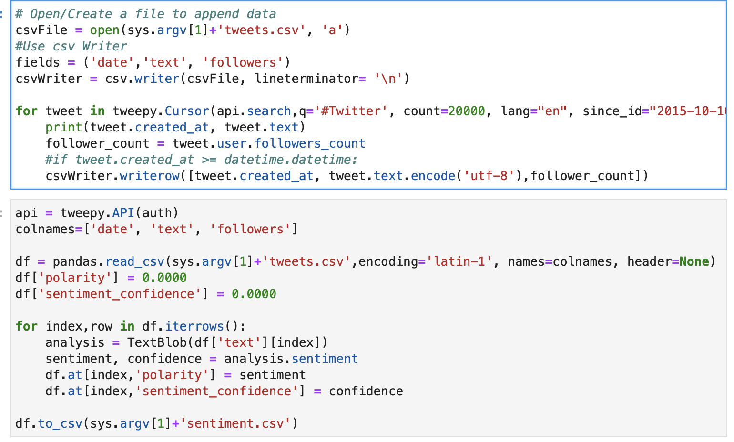

Natural Language Processing
Notes:
Philip

Slide 9
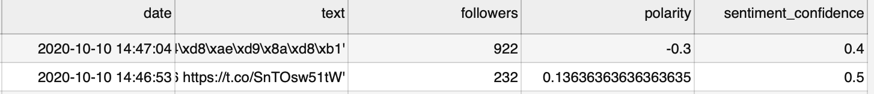
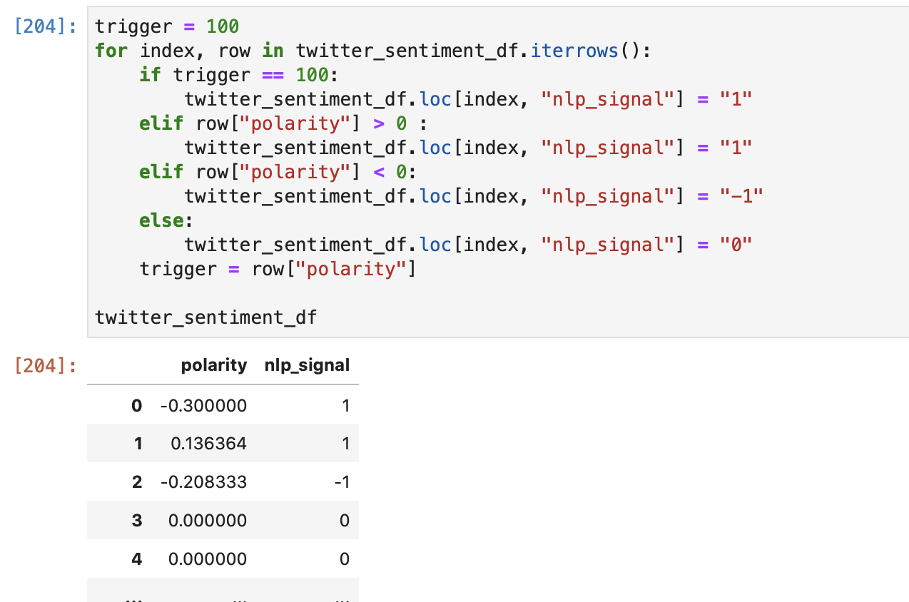
Twitter Data
1.
2.
3.
4.
Notes:
Philip

Slide 10
Models
Notes:
Kellye

Slide 11
Models
Random forest
Neural networks
Decision Tree
MLP Model
Notes:
Setup:

Slide 12
For each model we:
Studied the signals in different strategies
Built the features, or found examples online
Trained the model
Tested the model
And then we did the prediction and evaluation
This will tell you if you had a positive return or a negative one

Slide 13
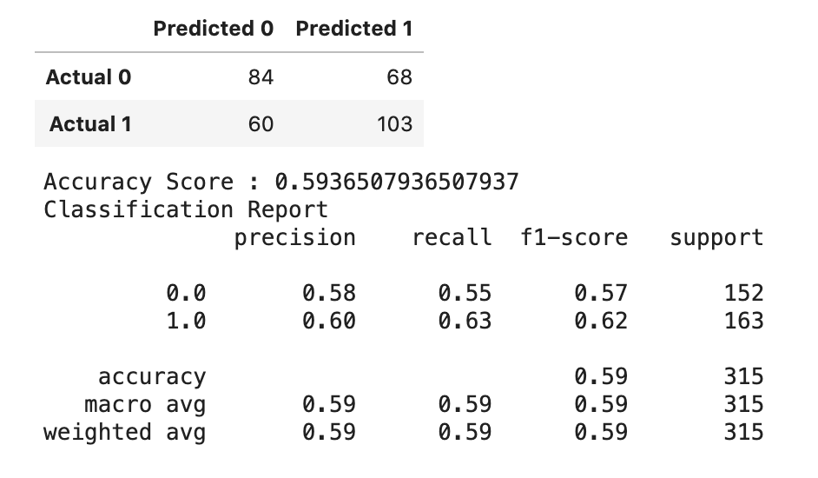
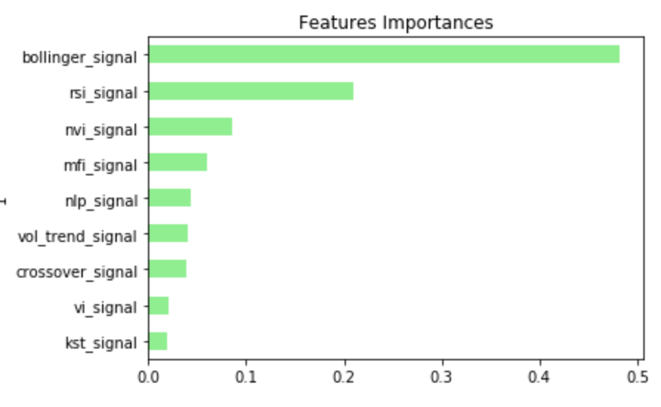
Random Forest Results

Slide 14
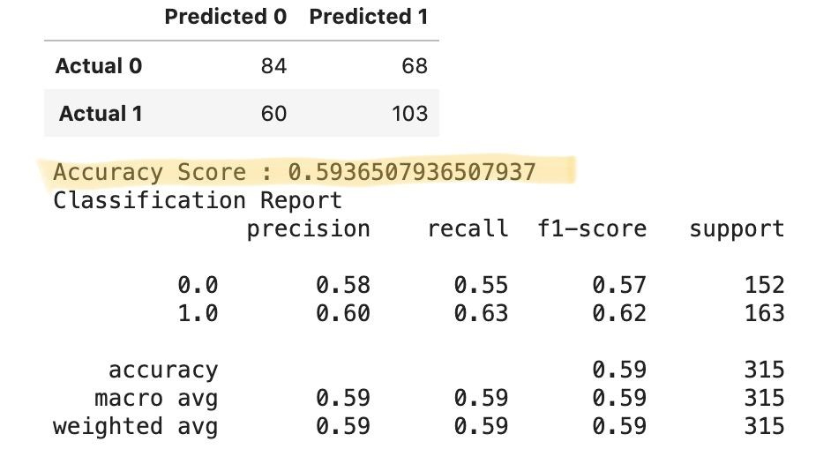
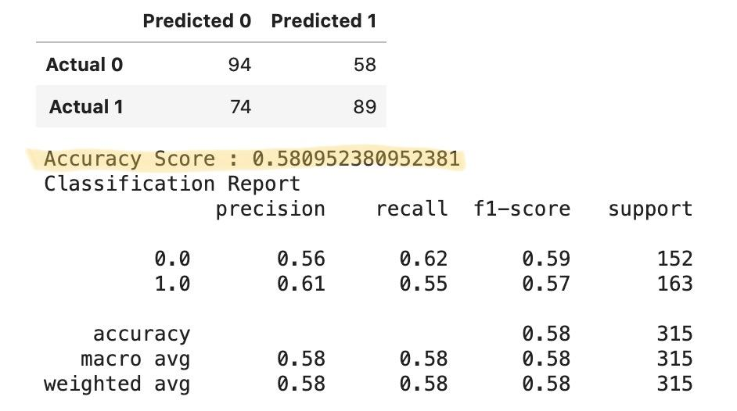
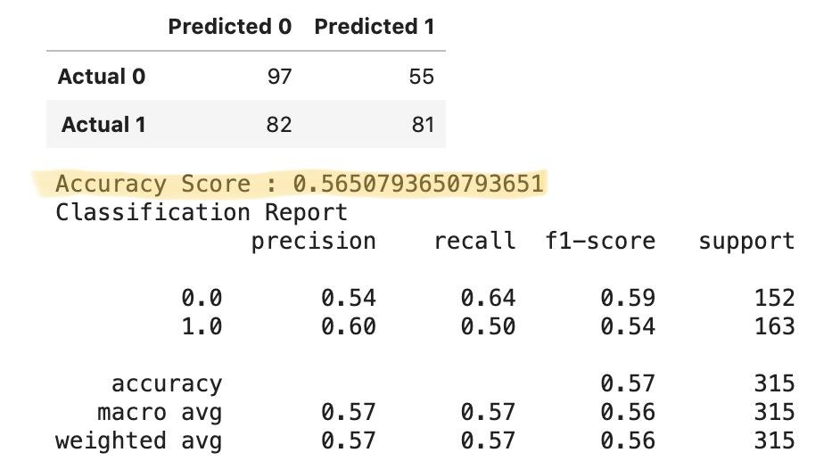
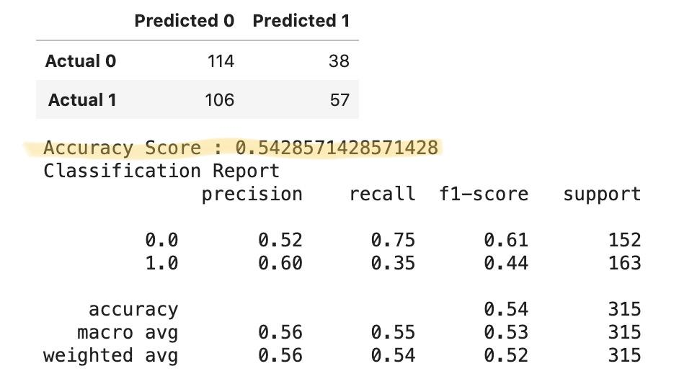
All 9 Features
Top 5 Features
Top 3 Features
The Top Feature

Slide 15
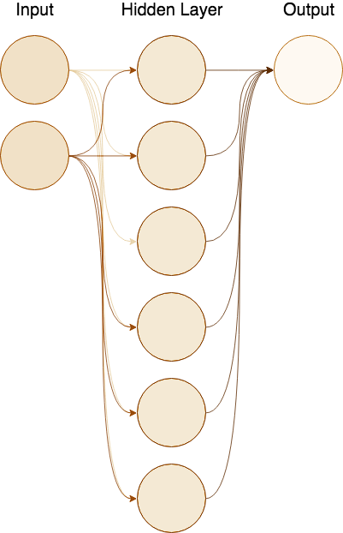
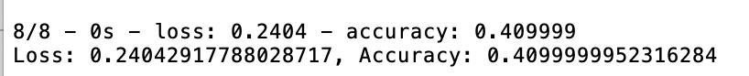
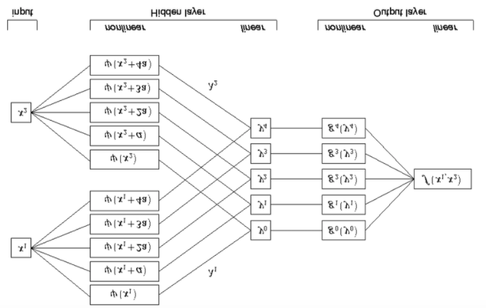
Neural Networks Results
Notes:
Artificial neural networks are forecasting methods that are based on simple mathematical models of the brain. They allow complex nonlinear relationships between the response variable and its predictors.
Could the KST be a hidden layer in a neural network that helps predict what will happen with stock prices? Could we train the neural network to apply KST.

Slide 16
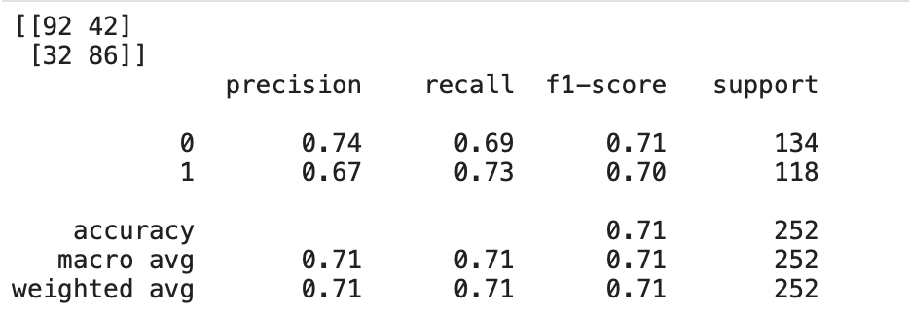
Multi Layer Perceptron Results

Slide 17
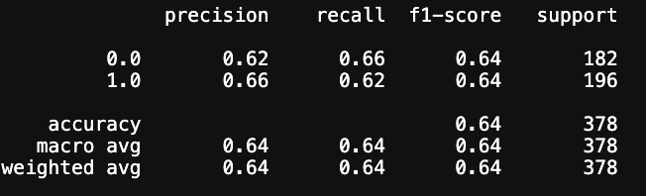
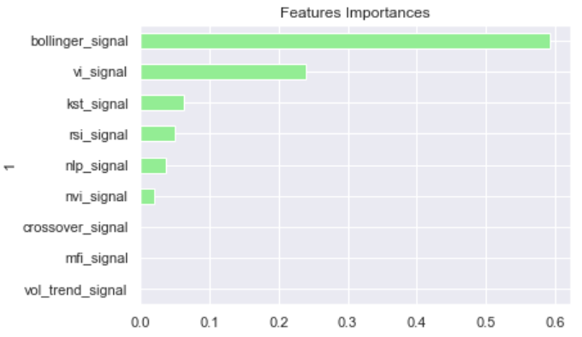
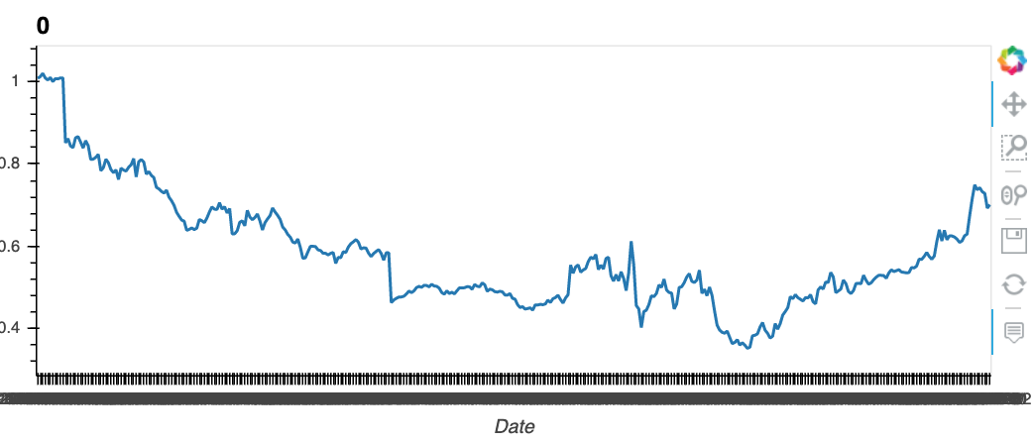
Decision Tree
Best results were achieved with:
criterion='gini', max_depth=3

Slide 18
Questions?

Slide 19
The End.
Thank you!

Slide 20
Slides below here are stock slides to pull from.

Slide 21


Slide 22


Slide 23
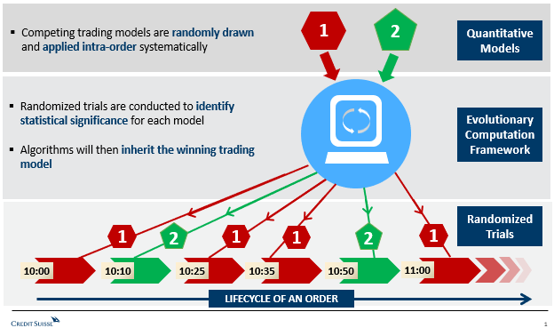
Notes:
This is similar to a lifecycle that Credit Suisse employ for their trading model evaluation and inclusion. Article: https://www.fixglobal.com/home/the-evolution-of-algorithmic-trading/

